Slide 1

Sepsis Analysis
Muskan | Hanymol | Sai | Sanket

Slide 2
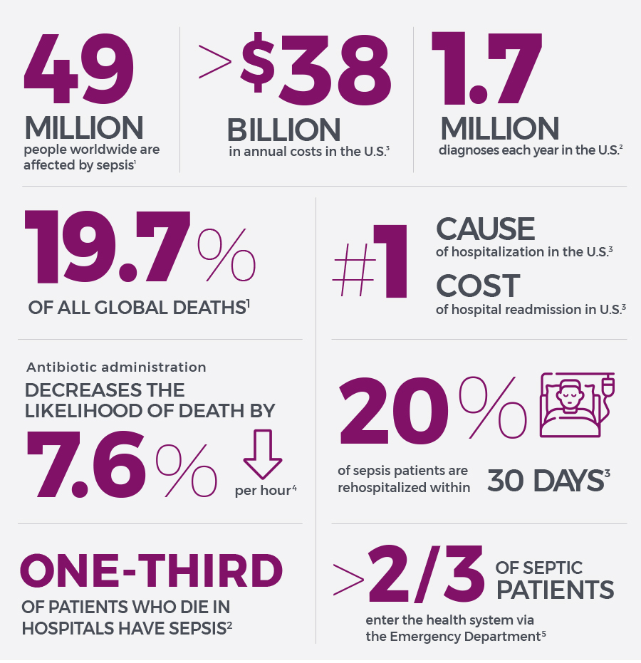
Introduction
Sepsis is a potentially life-threatening condition caused by the body’s response to an infection. In a usual case, the body releases chemicals into bloodstream to neutralise an infection. Sepsis occurs when the body’s response to these chemicals is out of balance, triggering changes that can damage multiple organ systems.
Sepsis is caused by infection and can happen to anyone. Sepsis is most common and most dangerous in:
Older adults
Pregnant women
Children younger than 1
People who have chronic conditions, such as diabetes, kidney or lung disease, or cancer
People who have weakened immune systems

Slide 3
Symptoms
S Shivering, fever, or very cold E Extreme pain or general discomfort (“worst ever”) P Pale or discolored skin S Sleepy, difficult to rouse, confused I “I feel like I might die!” S Short of breath

Slide 4
Objective
The early prediction of sepsis is potentially life-saving, and we aim to predict sepsis 6 hours and 12 hours before the clinical prediction of sepsis.

Slide 5
Dataset
Set A used for training
Set B used for testing
No target leakage policy has been strictly followed
We wrote code to combine all the PSV’s from respective A and B files in separate CSV’s

Slide 6
Methodology
Combine all PSV Data
Handling Missing Values
Feature Engineering
Handling Data Imbalance
Baseline prediction

Slide 7
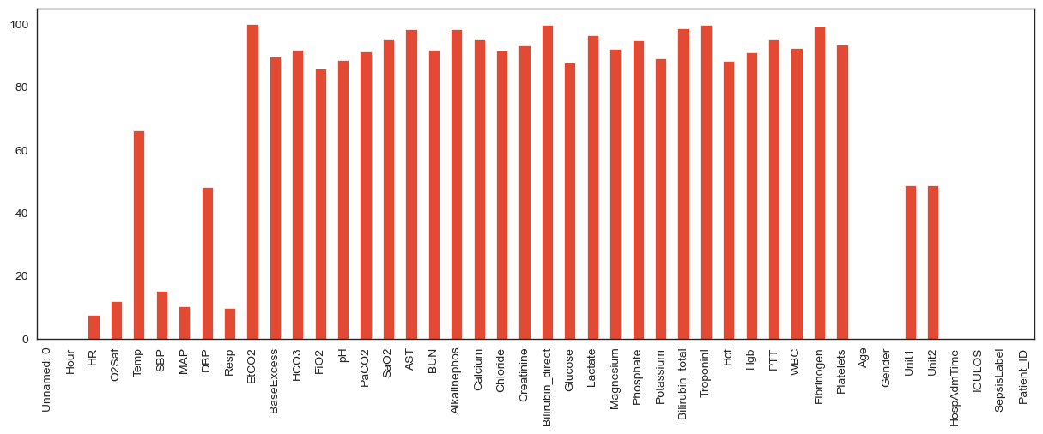
EDA _ Missing values
Avg. 85 % of the rows were empty.
We performed imputation with 2 methods;
The first method did not worked well, it was by imputing the values with group means of age and sepsis label.
The second method worked well, we performed backfilling for missing rows by grouping it on patient ID and the if still the data is missing then forward filling was applied. Ideally forward filling was required for very less data rows. It is giving better results
Simple logic here was that the current health condition of a person is carrying the backlog of his previous states.

Slide 8
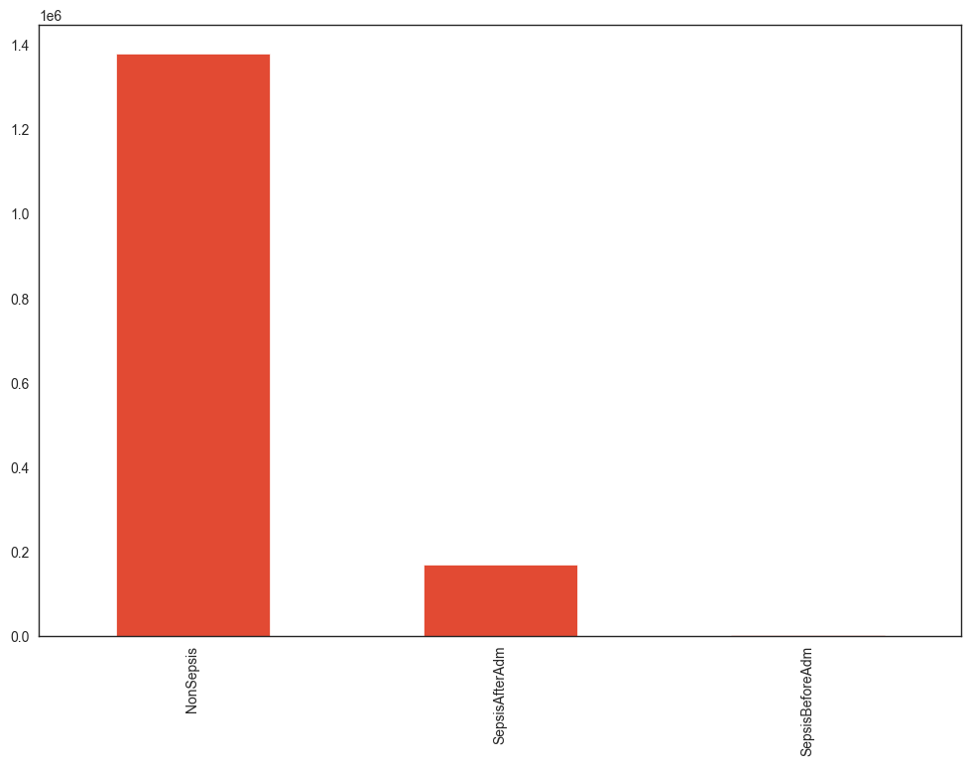
Labelled Data imbalance
The data is highly imbalanced for label 1.
Label 0 are in abundance.
So we decided to go with up sampling.
SMOTE was used to do so.
We did not performed SMOTE on test set B. It was only performed on test set A

Slide 9
Feature selection
From here we will start to do feature engineering.
Below parameters are something which we will be considering for predicting sepsis. This information has been picked from the link shared in the information ppt.
Temperature: A high fever or low body temperature can be a sign of infection.
Heart rate: A rapid heart rate may be present in sepsis.
Respiratory rate: Rapid breathing may be a sign of sepsis.
White blood cell count: A high white blood cell count may indicate the presence of infection or inflammation.

Slide 10
Feature selection
Oxygen saturation: Low oxygen saturation may indicate that the body is not getting enough oxygen, which can be a sign of sepsis.
Lactate levels: Elevated lactate levels can indicate that the body is not getting enough oxygen, which can be a sign of sepsis.
pH: Abnormal pH levels (either too high or too low) may indicate the presence of sepsis.
Base excess: Abnormal base excess levels may indicate the presence of sepsis.
Creatinine: Elevated creatinine levels may indicate kidney dysfunction, which can be a complication of sepsis.

Slide 11
Feature selection
Bilirubin: Elevated bilirubin levels may indicate liver dysfunction, which can be a complication of sepsis.
Troponin: Elevated troponin levels may indicate damage to the heart, which can be a complication of sepsis.
It is important to note that these parameters are only a few of the many that may be used to help diagnose sepsis, and they are not always present in all cases of sepsis. A healthcare provider will consider a range of clinical and laboratory findings in order to diagnose sepsis and determine the best course of treatment.

Slide 12
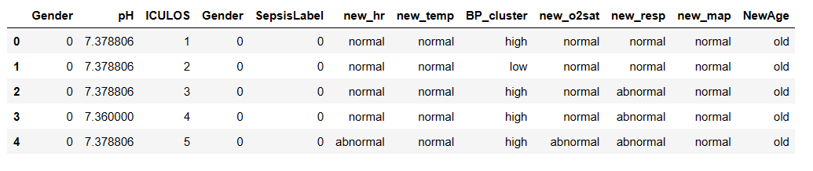
Output feature engineering

Slide 13
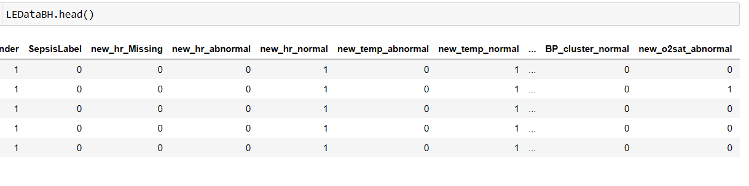
Encoded columns

Slide 14
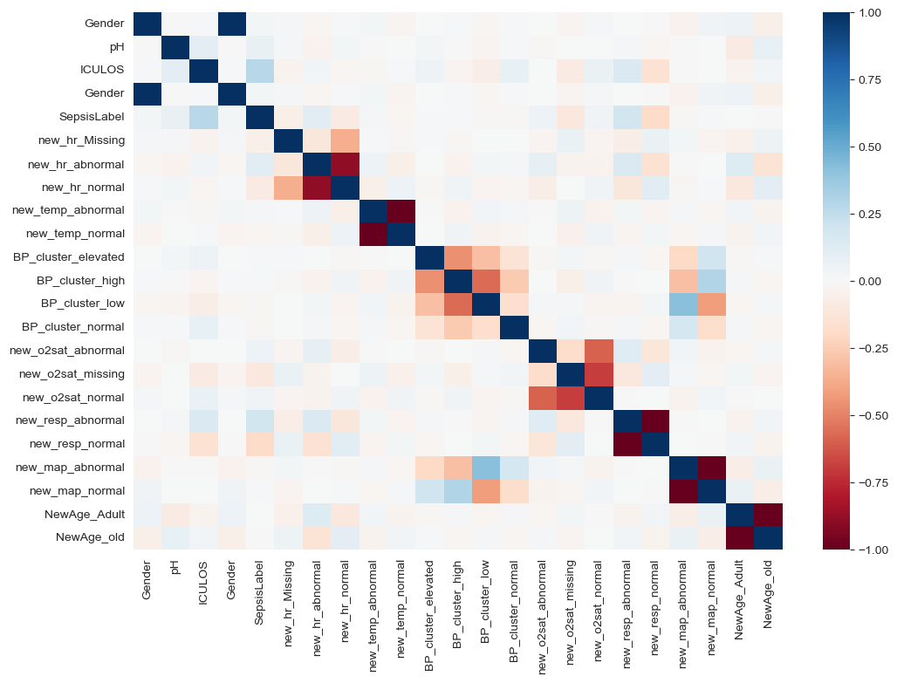
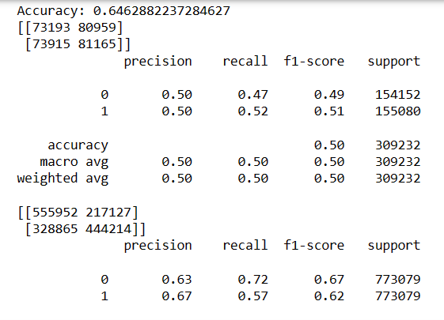
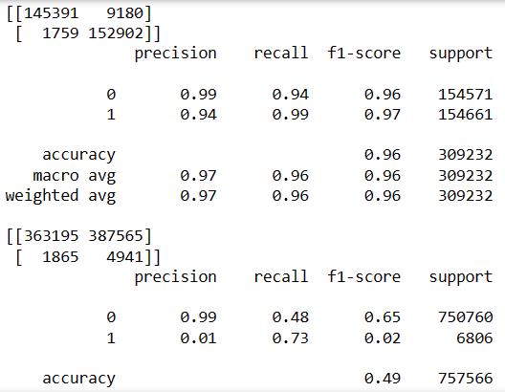
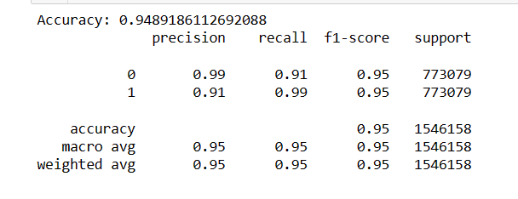
6 hours prediction results
XG boost
Random Forest
Logistic Regression

Slide 15
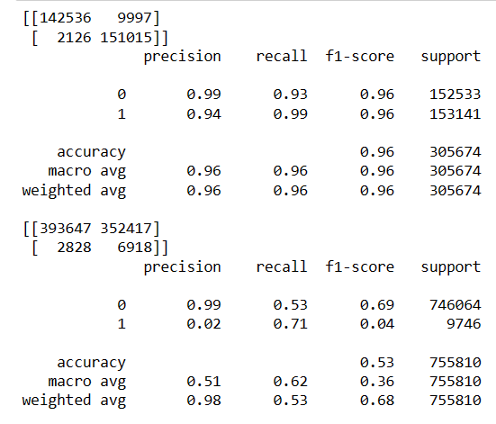
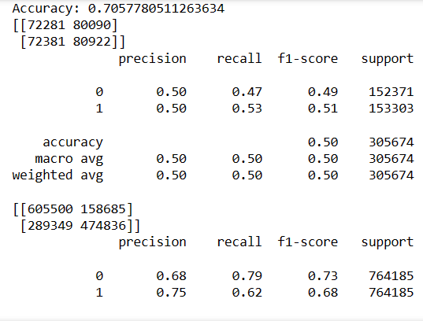

12 hours prediction results
XG boost
Random Forest
Logistic Regression

Slide 16




Conclusion
The project has a scope of continuing with further research on the importance of the features, better model building and under the guidance of a good health science domain expert.

Slide 17
References
[1] https://www.physionet.org/content/challenge-2019/1.0.0/
[2] https://www.datacamp.com/community/tutorials/decision-tree-classification-python
[3] https://towardsdatascience.com/using-bagging-and-boosting-to-improve-classification-tree-accuracy-6d3bb6c95e5b
[4] https://iopscience.iop.org/article/10.1088/1757-899X/428/1/012004
[5] https://machinelearningmastery.com/roc-curves-and-precision-recall-curves-for-classification-in-python/
[6] https://www.cdc.gov/
[7] https://www.ncbi.nlm.nih.gov/pmc/articles/PMC6429642/
[8] http://www.erogol.com/fighting-class-unbalance-supervised-ml-problem/

Slide 18

Thank you

